Slide 1
Welcome to Section
Week 6
Introduction to Data Structures
Slides by Cameron Mohne and Maggie Lee
Notes:
Did someone say dictionary? Welcome back to section! It is the final section of Code in Place, and I am so glad to have had all of you in my section! :)

Slide 2
01
02
Agenda
Check-in
Recap
How are you doing?
Going over lists and dictionaries again
03
04
05
Index Game
List Practice
Heads Up
Refreshing list indexing!
Get practice creating and modifying lists!
Get practice functionally utilizing lists!
Notes:
We have quite a bit on the agenda today! When it comes to data structures, the conversations are really endless. We have only introduced two types of data structures, but there are many more! We also don’t have enough time to cover all of the tiny details of even just lists and dictionaries! So what will we be covering?
We will have a small bit for our last check in. After that, we’ll go ahead and try to recap some of the important bits of data structures. Then, we’ll get into our section problems. The first is just a little game to warm up to indexing in lists. We’ll follow that up with a bit of practice with functions related to lists. Finally, we’ll finish things up with actually using lists to make our own implementation of a game!

Slide 3
Check-in
Unfortunately, it is the end of Code in Place. Let’s reminisce a bit, shall we? What was your favorite problem, section, or memory from your time here? I’ll go first!
Notes:
Unfortunately, it is the end of Code in Place. Let’s reminisce a bit, shall we? What was your favorite problem, section, or memory from your time here at Code in Place? I’ll go first!

Slide 4
Questions?
Notes:
It is also nice to look back on how far we’ve come, thanks for sharing everyone! Before we jump into the recap, are there any questions?

Slide 5
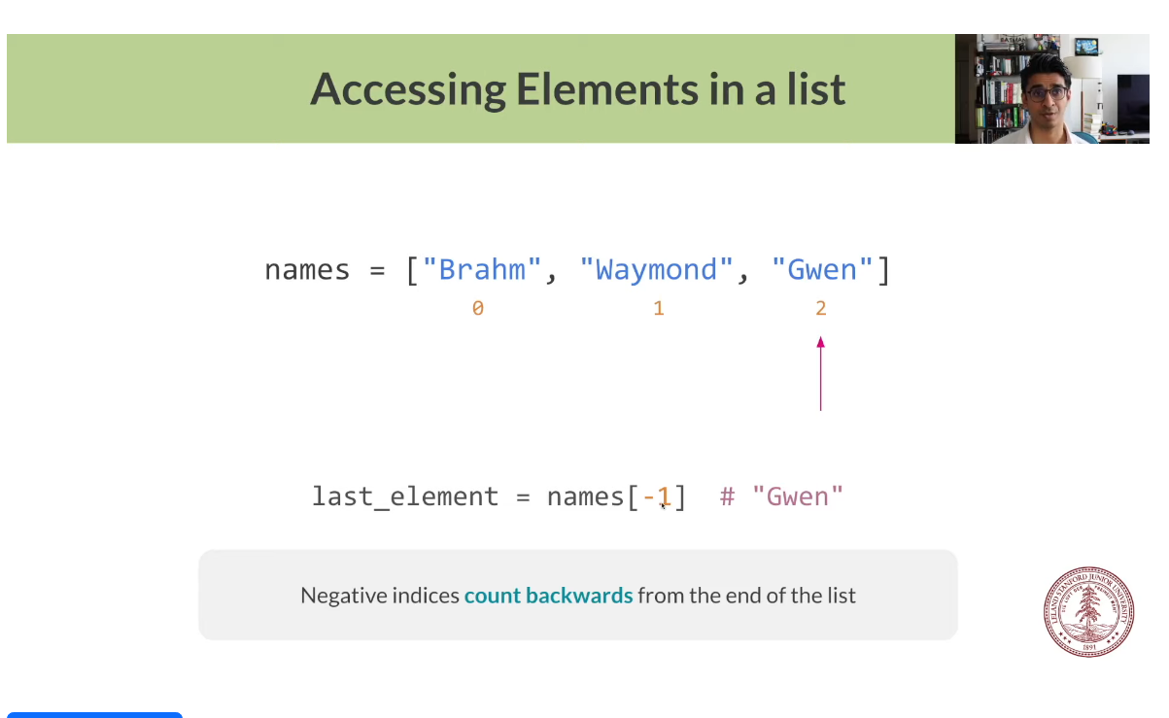
Recap
Notes:
Okay, let’s hop into things, shall we?

Slide 6
Data Structures
List
Dictionary
An ordered collection of values. Usually used to store a “list” of similar data. One example might be an attendance roster. It’s usually in order alphabetically (but it doesn’t have to be) and stores a list of names!
An unordered collection of key/value pairs. Usually used to store relational data. One example is a phone book or a contact list in a phone. Each name has a number associated with it!
Notes:
First, I want to reiterate the differences between lists and dictionaries.
Lists are an ordered collection of data values. This doesn’t mean that the data is necessarily sorted and organized, but that the data themselves have a tag on them which tells us and the computer where it is in the data structure. We usually store alike data in this list. For example, if you go grocery shopping, you might have a list of food that you might want to buy.
On the other end, dictionaries are much more relational. Dictionaries contain key/value pairs. What this means is that each key is associated with a value. The value can be anything really. It could be a string, number, list, or even another dictionary! The key is how we find the value when we are accessing the dictionary. The best example to imagine is either a phone book or the contact list in a phone. Every person and business usually has a phone number attached to the contact name. The name would be a key, and the phone number a value!

Slide 7
Lists
Some useful documentation:
list_name = []
list_name = [value_1, value_2, ..., value_n]
list_name.append(elem)
list_name.insert(index, elem)
list_name.remove(elem)
popped_item = list_name.pop(index)
accessed_item = list_name[index]
Notes:
A quick refresher on how to use lists!
First line is how to make an empty list
Second is how to create a list with values inside of it already
Third line is how to add to the back of the list
Fourth line is inserting an item at a specific index in the list
Fifth line is removing the first instance of an item
Sixth line is popping and returning an item at a specific index
The last line is how to access and return an element at a specific index

Slide 8
Lists
Some basic reminders regarding lists:
Lists are ordered, meaning you can access items (often called elements) using their index (what spot they are) in the list.
  Indexing starts at 0 in Python! This means that the very first element in a list has index 0.
Lists are mutable, if you make changes to a list in a helper function, they actually modify the list!
Lists don’t need to contain data of the same type. It is just more common.
  This means that a singular list can contain strings, integers, booleans, floats, and more.
We can find the length of a list using len(list_name)
Notes:
Just read the bold.

Slide 9
Dictionaries
Some useful documentation:
dict_name = {}
dict_name = {key: value, key2: value_2, ...}
dict_name[key] = value
del dict_name[key]
value = dict_name.pop(key, None)
value = dict_name[key]
value = dict_name.get(key)
Maggie’s favorite keyword!
Notes:
A quick refresher on how to use lists!
First line is how to make an empty dict
Second is how to create a dict with key/value pairs inside of it already
Third line is how to add a new item to the dict
Fourth line is deleting a key/value pair from a dictionary
Fifth line is returning a key’s value and then deleting the key/value pair from the dictionary. You can technically leave out the ‘None’ part, leaving it in means that if the key wasn’t found, then the default value you want to return is None. If you leave it out, it’ll throw an error instead.
Sixth line is unsafely accessing a key’s value and returning it
The last line is how to access and return a key’s value without needing to check if it’s in the dict first. It’ll just return None instead (or you can set its value like how we did with pop).

Slide 10
Dictionaries
Some basic reminders regarding dictionaries:
Often short handed in writing/speech to dict.
Also mutable, just like lists
Make sure keys are in a dictionary or have some check to see if they are there before trying to access or delete data.
  This is usually needed when trying to use user input in conjunction with dictionaries
Keys have to be unique
Keys can be anything that is hashable, are often strings, though.
Notes:
Just read the bold.
If they ask about hashability and you don’t know anything about that, send them to the public forum.

Slide 11
Questions?
Notes:
Before we jump into the recap, are there any questions?

Slide 12
Index Game
Notes:
(Takes place in the IDE) https://codeinplace.stanford.edu/cip4/ide/a/indexgame
We are going to play a quick game to reinforce our knowledge of how indexing works with lists. We’ve already been given code for the game, so I’m going to go ahead and open it and we can play!

Slide 13
List Practice
Notes:
https://codeinplace.stanford.edu/cip4/ide/a/fruitlist
Next, we are going to revisit our understanding of some of the functionalities lists have as a precursor to our last section problem.
(Would recommend short breakout rooms or individual writing for a bit with a group recap)

Slide 14
Questions?
Notes:
Before we head into our last section problem, are there any questions over indexing, list functions, or anything else?

Slide 15
Heads Up
Notes:
Now, we can get into the final section problem of Code in Place, how exciting! The problem is called Heads Up and should hopefully combine the prior knowledge from the previous two problems.

Slide 16
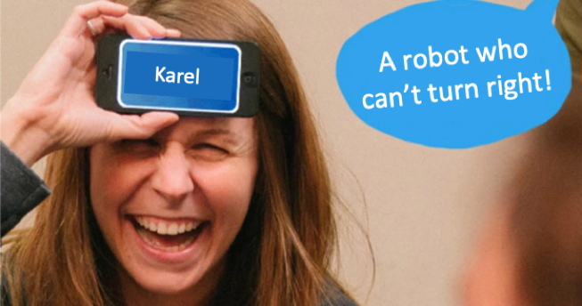
Problem Premise
Heads Up is a game where one person takes the role of a “guesser”.
A word will be generated at random, and everyone who isn’t the guesser will provide hints as to what the word is, without saying the actual word.
The guessers job is to guess what the word is as fast as possible! An example of a round of this game is shown on the right.
Notes:
First, what even is Heads Up?
Well it’s a party game that is pretty popular in the United States (and perhaps elsewhere?)
How it works is a program generates a random word. There will be a person with their eyes closed who is the guesser. The rest of the section will be trying to give verbal hints as to what the word is without saying the actual word or parts of the word. The guesser has to use those hints to guess the word as fast as possible!

Slide 17

Problem Overview
We are all going to become game developers today, as our job is to recreate the functionality of this game!
We are going to take a list of words from a file and then use that list with our knowledge of Python to recreate a console-based version of this game!
Notes:
Our job is to put on our game developer hats and recreate the base functionality of this game. We want to take a list of words and be able to mimic the flow of the game.

Slide 18
End Goal
Example Input
Example Output
(Example Word List)
Apple
Banana
Pear
Blueberry
Strawberry
Longan
Lychee
Tamarind
Orange
The word to guess: Lychee
Hit ‘enter’ to get the next word.
The word to guess: Pear
Hit ‘enter’ to get the next word.
The word to guess: Longan
Hit ‘enter’ to get the next word.
...
Notes:
An example might be here, where we have a word list containing fruit names. An example output from our program might be something like this on the right where we get a word to guess, the program stops while we play, and then we move on to the next word when we are ready.

Slide 19
Problem Details
Words
We provide a list of words for you to use in a file named “cswords.txt”.
Files
We are given a function that will read words from a file for us called get_words_from_file(...).
Game Loop
We want to repeat the game infinitely (or until we hit the stop button at the top of the IDE)
Notes:
Some important details is that we already have a list of words we can use. We have a function to read the words from a file into a list for us already. And lastly, we want to keep playing the game forever until we use the stop button at the top. This is just to make life a bit easier!

Slide 20
Coding Time!
Notes:
With that, it’s time to code!
https://codeinplace.stanford.edu/cip4/ide/a/headsup
(Would recommend either breakout or whole group.)

Slide 21
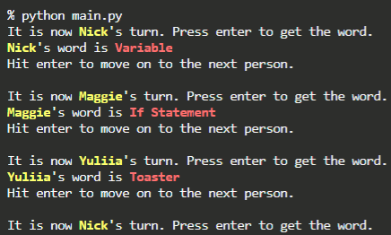
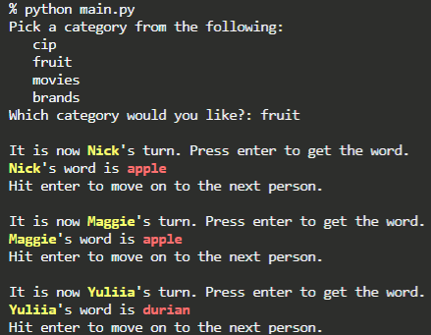
Extensions
Organization:
Cycle through names so people have turns. Great for virtual play!
Categories:
Make your own word lists and add categories to play with!
(Bonus points for using a dictionary!)
Notes:
Some extensions might be to make our game a bit more robust! Here are two examples.
For the first, we might make it so we can have our players’ names which cycles to make things a bit more organized when playing.
For the second, we might want to make categories of words so we can play with different words which might be more recognizable for a different audience!

Slide 22
Thank You
This experience wouldn’t be possible without all you amazing students! It was a joy working with you during this iteration of Code in Place!!!
Notes:
To close out, I just want to thank you all for being an amazing group of students. It was a lot of fun and I hope you all learned a lot! If you think about it, not too many weeks ago you might’ve had zero programming knowledge and were playing around with Karel. Now you are creating animations, games, and I’m sure much more to come!

